Slide 1

UBUHLEBETHU CONNECTPRO
Web Platform User Experience & Architecture Showcase
INTERACTIVE SYSTEM TOUR • TEAM 13: TECH TITANS
How the ConnectPro Web Platform Works & Looks
A complete walkthrough of the desktop workstation: from public discovery and currency-converted quotes to commercial approvals and site operations.

Slide 2

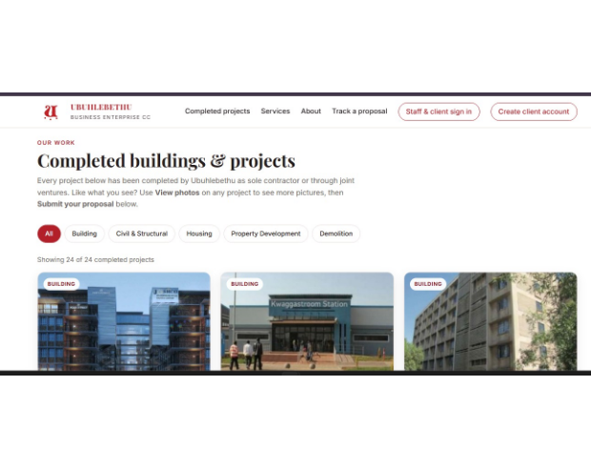
STEP 01 • PUBLIC HOME & DISCOVERY
Browse Past Projects & Initiate Tenders
1
Verified Building Portfolio
Prospective clients browse 24 completed projects like 27 Hoek Street (R 77.6M) and Kwaggastroom Station with multi-photo lightboxes.
2
Project Categorization
Filter seamlessly across Building, Civil & Structural, Housing, Property Development, and Demolitions.
3
Instant Call-to-Action
One-click entry to the tender quotation form or direct proposal tracking without pre-registration hurdles.

Slide 3
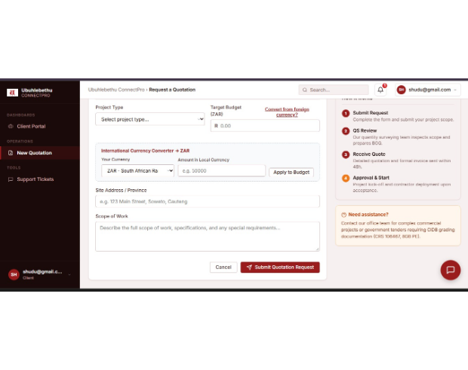
STEP 02 • CLIENT TENDER REQUEST
Foreign Currency Converter to Rands (ZAR)
1
Live Currency Converter
International clients enter amounts in foreign currencies (USD, EUR, GBP, BWP, NAD, ZMW) and click Apply to Budget to populate South African Rands.
2
Side-by-Side Guided Flow
"How it works" and "Need assistance" cards are pinned directly alongside the form, guiding users through QS review and BOQ preparation.
3
Complete Scope Capture
Captures organization name, site location, and technical project scope with support for tender document uploads.

Slide 4
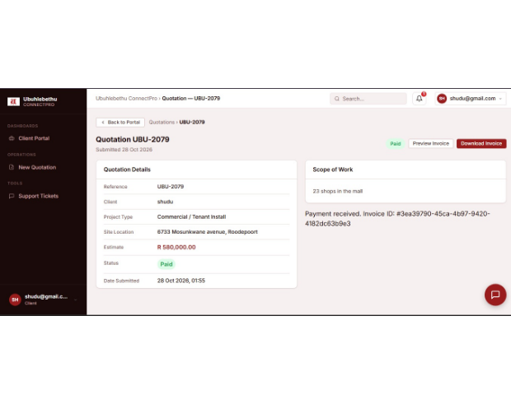
STEP 03 • QUOTATION LIFECYCLE & BILLING
Live Status Tracking & SARS Tax Invoices
1
Public Proposal Tracking
Clients track quotation progression (Submitted → Reviewed → Approved → Invoiced → Paid) without needing to contact the office.
2
Automated 15% VAT Invoicing
Approving a quote automatically builds an official tax invoice containing company VAT numbers, payment terms, and FNB bank details.
3
Preview, Download & Print
One-click vector PDF generation and clean printable views give clients physical documents for their internal finance teams.

Slide 5
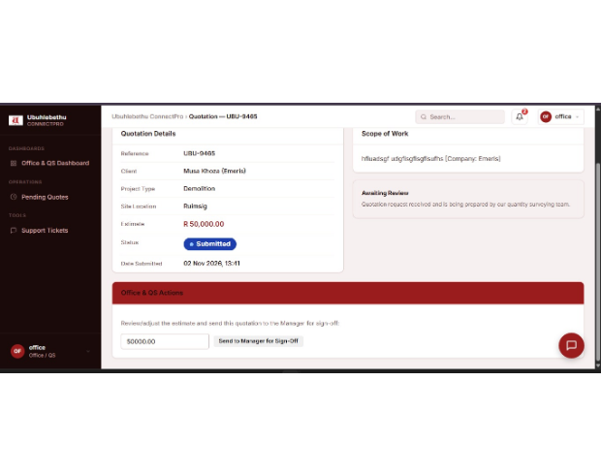
STEP 04 • OFFICE & QUANTITY SURVEYING
Reviewing Quotes & Commercial Sign-Off
1
Centralized Pending Queue
Incoming requests arrive in the Pending Quotes workspace, displaying client name, scope, and target budget.
2
QS Cost Adjustment
The Quantity Surveyor evaluates the project, overrides or adjusts the cost estimate (e.g. R 50,000.00), and sends it to the Manager for sign-off.
3
Human-in-the-Loop Safeguards
Provisional AI suggestions are strictly internal drafts; no quote is released without human quantity surveyor validation.

Slide 6
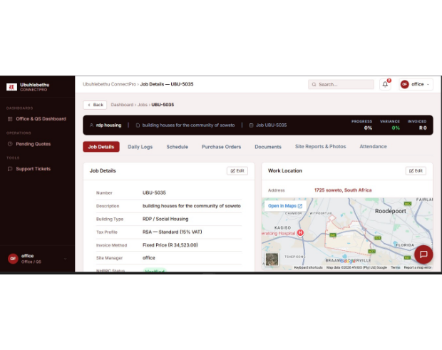
STEP 05 • OPERATIONS & PROJECT CONTROL
Jobs in Progress & 5 Operational Work Tabs
From Jobs in Progress, staff open active projects (e.g. UBU-5035 Soweto Housing) with full tracking across five dedicated tabs:
1. Daily Logs: Site observations with author stamps and progress percentages.
2. Project Schedule: Phase milestones with target completion dates and staff assignments.
3. Purchase Orders: Supplier tracking from material order to delivery confirmation.
4. Document Manager: Upload engineering drawings, BOQs, and site permits (up to 2MB).
5. Work Location & Maps: Pinpoint street addresses mapped with Google Maps integration.

Slide 7
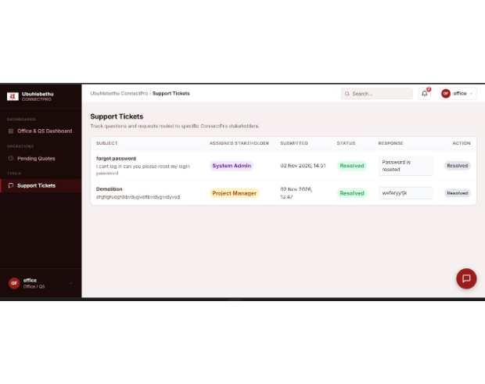
STEP 06 • GOVERNANCE & WORKFORCE SUPPORT
Site Attendance & Smart Ticket Routing
1
Site Worker Attendance
The Attendance dashboard gives management a live view of on-site field staff with check-in/out timestamps and daily rate tallies.
2
Smart Stakeholder Routing
Tickets automatically route by keyword: [Project Manager] for site/demolition queries, [Office/QS] for billing, and [System Admin] for access.
3
Dual Alerts: In-App & Email
Replies instantly update the client portal, increment the navbar notification bell, and dispatch an official HTML email via Brevo SMTP.

Slide 8
ACCESS & SECURITY
Role-Based Access Control (RBAC)
ROLE 01
ROLE 02
ROLE 03
ROLE 04
Client Portal
Office / QS
Site & Field Staff
Executive Admin
Submit tender proposals, convert foreign budgets to ZAR, track status, and view VAT invoices.
Review incoming tenders, adjust BOQ pricing, issue tax invoices, and manage active jobs.
GPS shift attendance, daily construction logs, progress reports, and milestone tracking.
User account management, role assignment, system settings, and full POPIA audit logs.

Slide 9
QUANTIFIED BUSINESS VALUE
Proven Efficiency Gains
Reduced from 4–7 days of site visits
< 2h
Zero lost quotes in email threads
100%
Instant SARS-compliant PDF invoices
15%
Daily logs, schedules, POs, docs & GPS
5 Tabs
Quotation Turnaround
Digital Transparency
Automated VAT Billing
Job Site Control

Slide 10
REFINEMENTS & POLISH
Task 3 Lecturer Feedback Addressed
Area | Feedback Received | Delivered Resolution
1. Data Export | Fix export button; remove confusing print icon | Replaced with CSV download icon, formula escaping, and UTF-8 encoding
2. Status Badges | Make Submitted button bigger/better color | Deep-blue badge (.badge-submitted) with live status dot
3. Currency Tool | Add currency conversion for external clients | Built standalone & in-form ZAR currency converter with cached rates
4. Unused Buttons | Buttons that did nothing on Job Details page | Connected all 5 tabs (Daily Logs, Milestones, POs, Documents, Maps) to real API actions

Slide 11
ENGINEERING STANDARDS
Built on Modern .NET 10 Standards
Sub-second database querying
< 2s
Consolidated web and mobile endpoints
REST
JWT tokens, rate limits & CSRF protection
TLS
Zero compiler errors or runtime crashes
0 Bugs
API Response Time
Shared API Backend
End-to-End Security
Clean Build

Slide 12


Ubuhlebethu ConnectPro
Seamless construction operations across clients, estimators, quantity surveyors, and active job sites.
Team 13: Tech Titans
Ready for Live Demo
Thank You • Questions & Discussion

